Slide 1
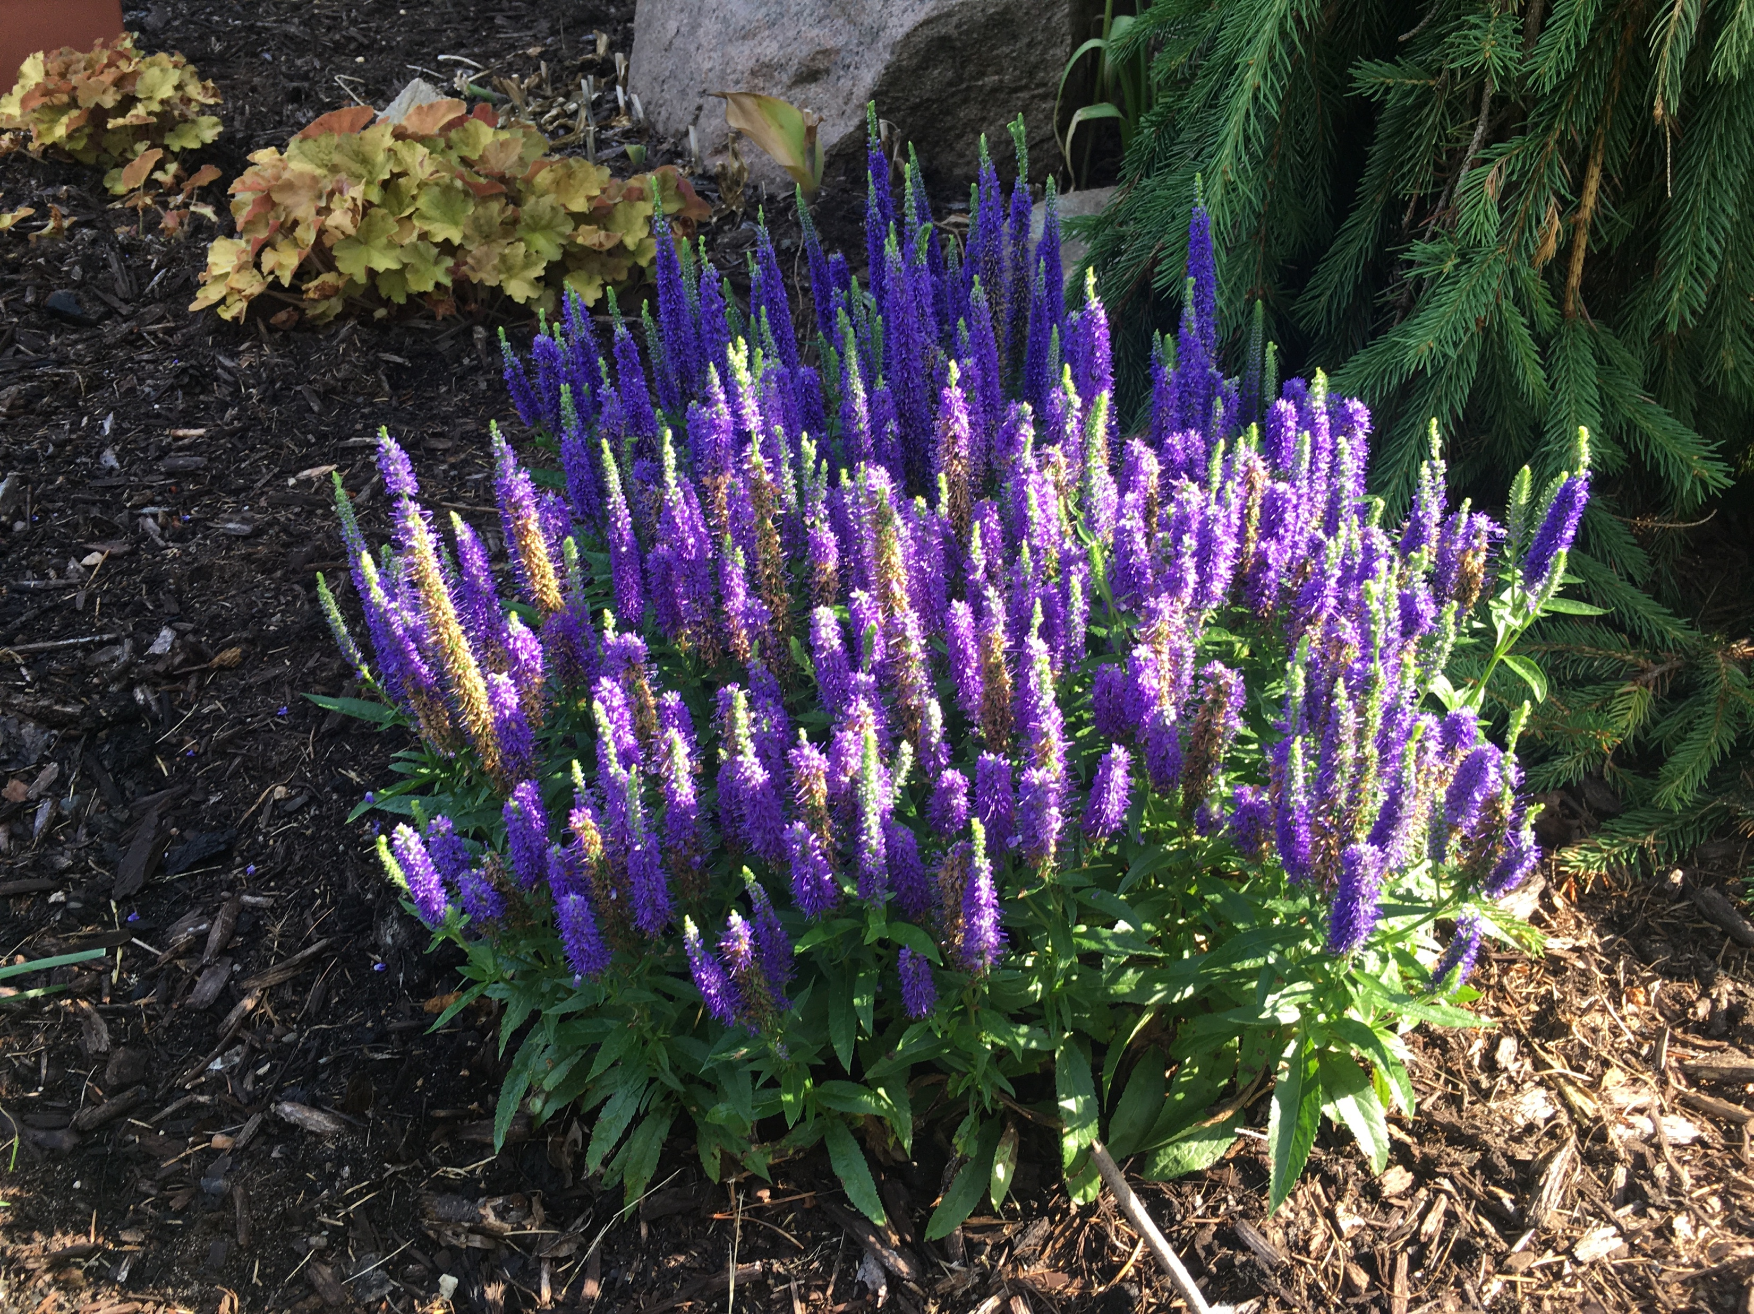
July
Happy 4th of July Everyone
Purple Veronica
Stella d’oro
Info is gathered from Sharon Morrisey, Consumer Horticulture Agent, University of Wisconsin-Extension in Milwaukee Co.
See last page for website

Slide 2
July
Garden flowers, whether annuals or perennials, benefit from "deadheading" after flowering. By removing the spent flower heads, energy is used to produce more flowers or foliage and roots. Some will produce another flush of blooms.
In general, flowering requires lots of energy so it can be quite helpful to fertilize flowering annual plants once flowering begins. Fertilize one more time before the end of the season.
Keep cole crops and potatoes covered with floating row cover to exclude cabbage worm and leafhoppers. Cole crops such as cauliflower, broccoli, and cabbage can be sprayed or dusted with Dipel (Bacillus thuringiensis), a biological control product. M-trak is a similar biological control for potato beetles.
Seeds can continue to be sown throughout July for late crops of beets, bush beans, carrots, chard, Chinese cabbage, cucumbers, kohlrabi, and corn. For summer planting, moisten the furrows before sowing seeds. Cover with pre-moistened potting soil mix which will not be so likely to crust and crack. To hold in the moisture, cover the rows with a very thin layer of mulch or floating row cover fabric.

Slide 3
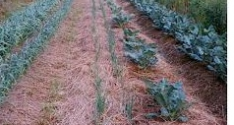
First Week
Tomatoes
Just a reminder-- Don't fertilize tomatoes until the first fruit has set. Too much nitrogen will cause leafy growth at the expense of flowers and fruit. Most other plants, however, benefit from a starter fertilizer when transplanted.
Watch the leaves of your tomato plants for signs of leaf spot diseases. The most common ones, septoria and early blight, appear on lower leaves first and can sometimes be effectively controlled if leaves are removed as soon as leaf spots are seen. If it has gotten away from you, chemical control is also possible with a fungicide containing chlorothalonil. Organic gardeners can use products containing copper.
Click the below link for more info
Growing Tomatoes in Wisconsin
Septoria and Early Blight
Finish mulching or add mulch as your plants grow. Use organic or inorganic mulching materials. You can tailor your mulching materials to your plants. Do your plants like cooler or warmer soil??
All About Mulching
To prevent bacterial wilt of squashes, melons, cucumbers, and gourds, control the striped and spotted cucumber beetles. Use carbaryl either as a dust or spray late in the day after flowers have closed and bees are no longer active. Organic gardeners can use products containing spinosad. Plants already infected with the wilt should be removed and destroyed immediately.
Bacterial Wilt Info
Cucumber Beetles
Trees and shrubs should not be fertilized until leaves begin to color and drop this fall. Fertilizing is only recommended if trees are stressed by insects or diseases, damage, or environmental conditions such as drought. Symptoms are small, pales leaves or a thin canopy. Fertilizing, like pruning, stimulates new growth.
Pull Weeds

Slide 4
Second Week
Keep watching your Oak, elm, ash, and maples infected with one of the wilt diseases will begin to show typical symptoms as the summer heats up.
More Oak wilt information click here
Fertilize your lawn for the second time of the season. This is optional if your lawn is over 15 years old and has been regularly fertilized for that long. Do not use a weed ‘n feed at this time.
Watch for cabbage worms, corn borers, cutworms, potato leafhoppers, potato beetles, aphids, tarnished plantbugs, and thrips on many vegetable crops.
Managing Insects in the Home Garden
Potato Leafhopper
Begin looking for webs of fall webworm on woody plants. Control by cutting out branches wrapped in webbing where possible.
Spraying with the biological insecticide B.t.
(Dipel, Thuricide, and others) is very effective while larvae are young.
Webworm Info
Cabbage worm
Pull Weeds

Slide 5
Third Week
Summer raspberries should be coming in well now. Watch plantings closely for the many possible insect and disease problems. Harvest fruit often and thoroughly to reduce the number of picnic bugs, yellow jackets and multi-colored Asian ladybeetles competing with you for fruit. Viruses cause plants to be stunted and discolored, and fruits to crumble easily. See UW-Extension publication A1610 for pest descriptions and controls.
Also watch for a new raspberry pest, spotted winged drosophila. It is a tiny fruit fly that lays eggs on ripe fruit including grapes and blueberries, too. The larvae are very small and may not appear until after harvest.
Fertilize asparagus plantings with 10-10-10 fertilizer now.
Watch for yellowing and wilted leaves on cole crops such as broccoli, cauliflower, and cabbage. This may indicate black rot or club root, two serious diseases of these crops
Club Root Disease
Watch for slugs in shaded cool areas in your mulched areas. Slugs damage plants by chewing large, irregular holes in leaves, stems, flowers or fruits. Most feeding occurs at night or during dark, cloudy days. A shiny trail of mucus (slime) may be associated with the damage. Vegetables and fruit in direct contact with the soil are attacked more frequently than those off the ground. In Wisconsin, tomatoes are often damaged just as they ripen.
Slug Info
Pull weeds
Divide iris plantings every 3 - 5 years to renovate plantings, remove and dispose of borer infested rhizomes and replant the healthy ones.
Slug damage on hosta leaf

Slide 6

Fourth Week
Alpine currant shrubs infected with the anthracnose fungus will lose leaves and sometimes completely defoliate by mid-summer. Fallen leaves will be spotted with the fungus and should be diligently removed and destroyed to reduce the infection next year.
Anthracnose Info
Honeysuckles susceptible to the common leaffolding aphid should be sprayed every 10 - 14 days with insecticidal soap. Pruning out infected stems every fall will reduce the population considerably but the prevalence of the insect means that others will probably fly in again. Since many species of honeysuckle are invasive especially in our natural areas, it might be best to consider replacing them with something else.
Leaffolding Aphid
It’s HOT, take a road trip to our many gardens and enjoy a picnic.
Oh yah—And pull more weeds

Slide 7
Visit the below website for more information on July gardening
https://milwaukee.extension.wisc.edu/files/2016/11/JulyGardenCal2016.pdf

